Slide 1

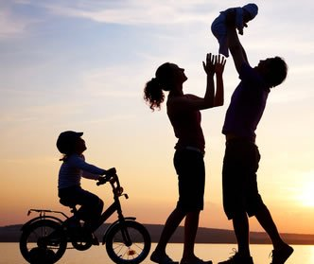

My family

Slide 2
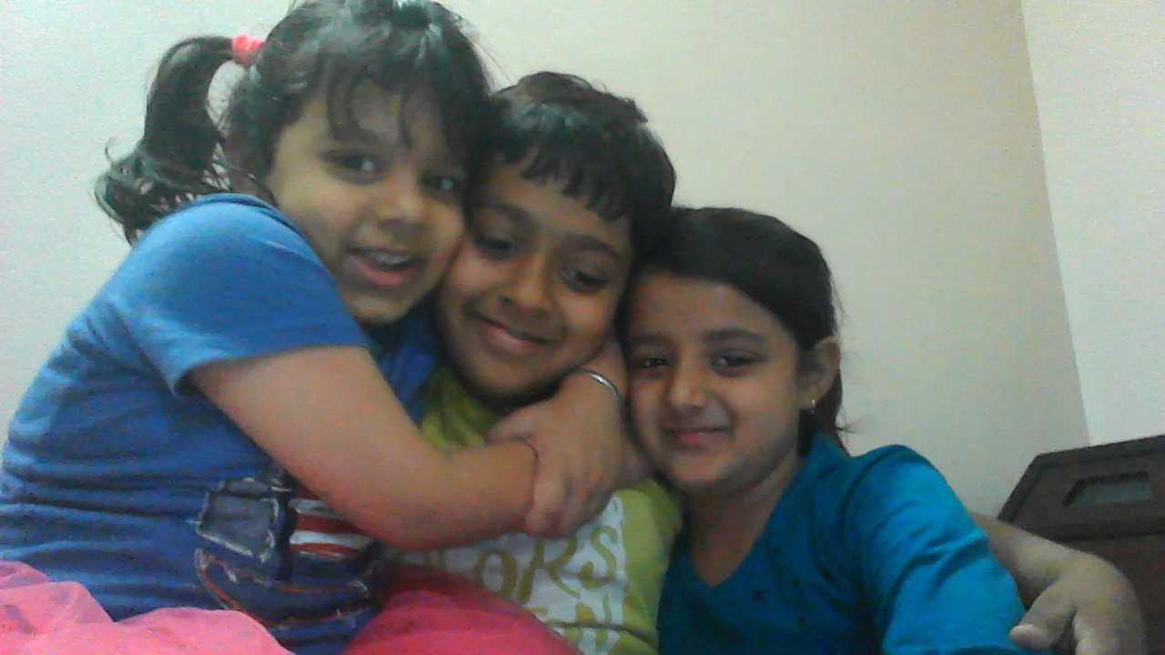
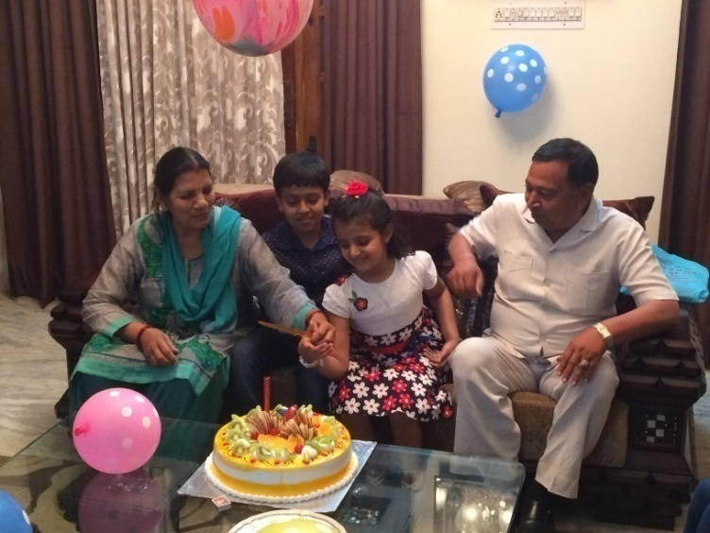
MY FAMILY IS VERY
PRECIOUS FOR ME

Slide 3
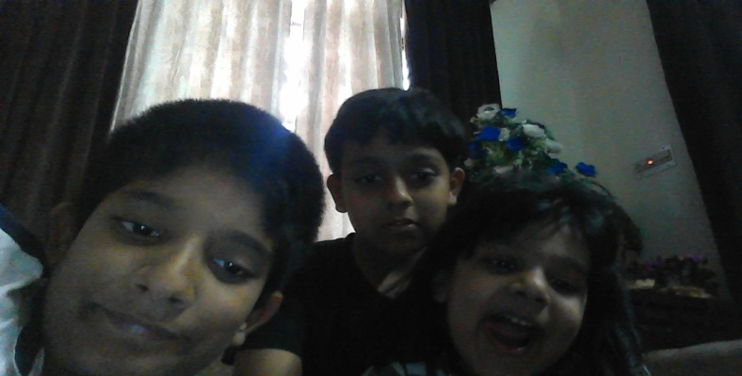
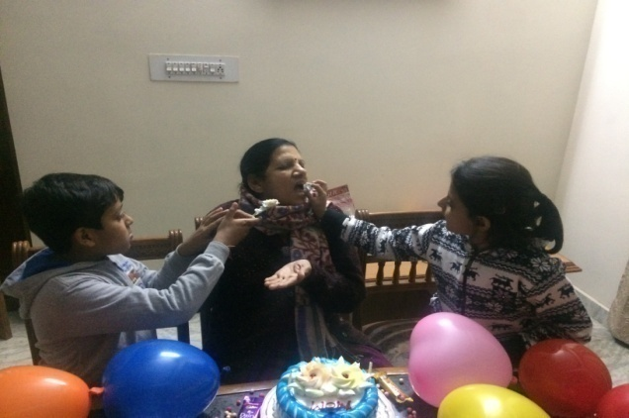
I HAVE A VERY HAPPY FAMILY
MY FAMILY IS VERY
SENSITIVE

Slide 4
MY FAMILY ALWAYS HELP ME IN DANGER’s CONDITION

Slide 5
I ALSO LOVE TO VISIT DIFFERENT PLACES DURING WEEKENDS WITH MY FAMILY

Slide 6
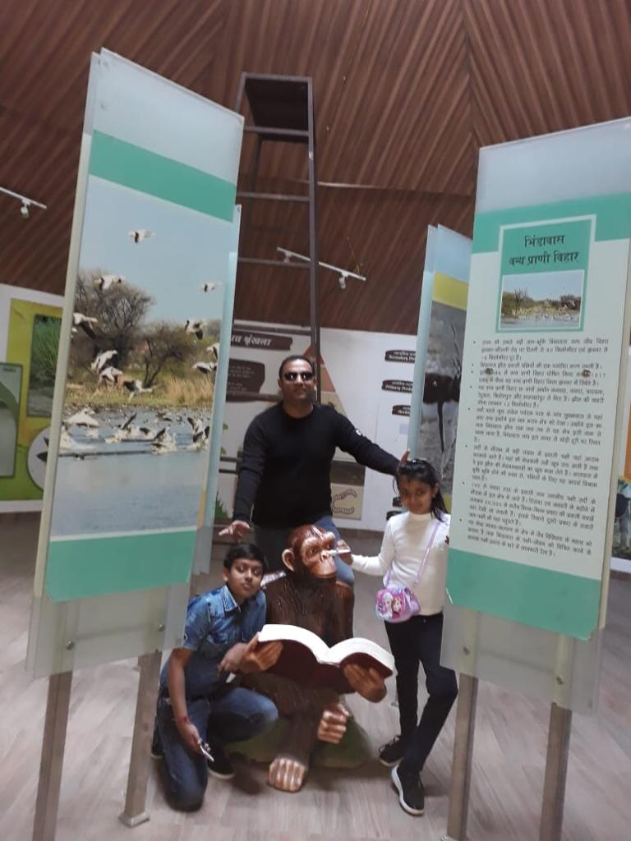
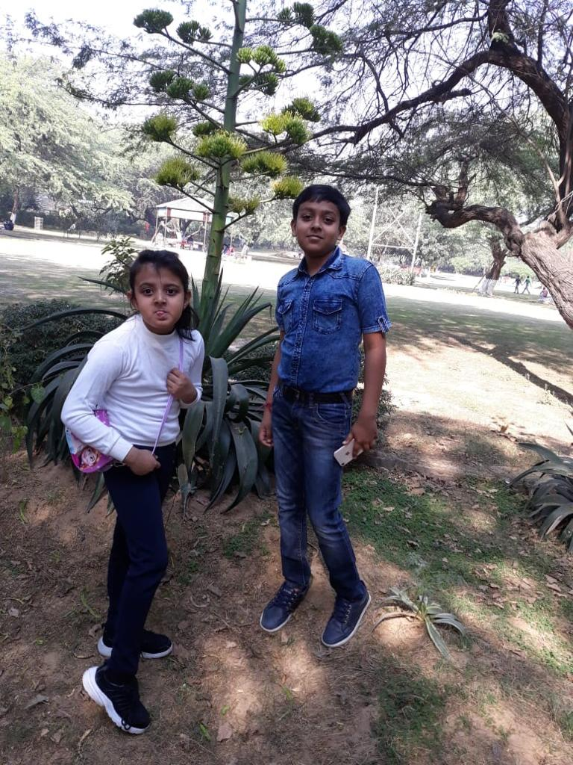

Slide 7
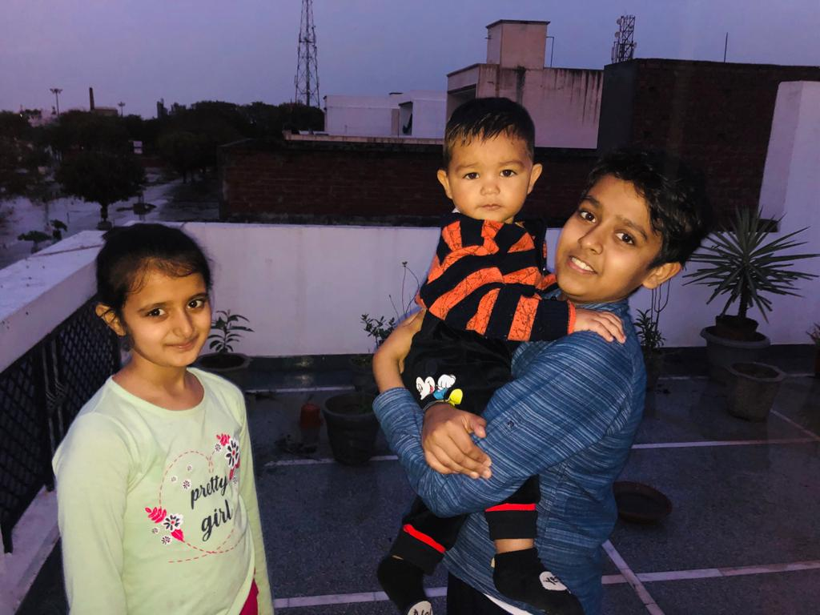
I LOVE MY FAMILY TOO MUCH

Slide 8
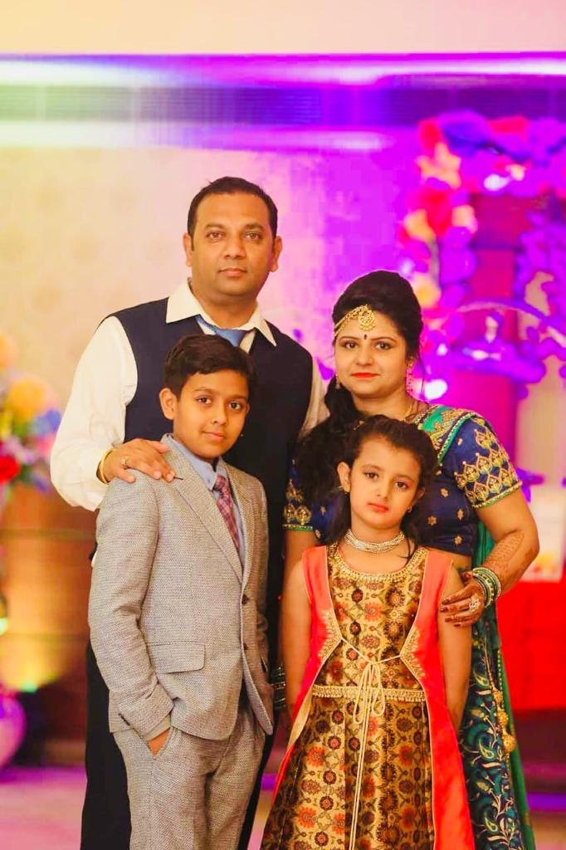

Slide 9


